Slide 2
FIT 152 Fundamentals of Information Technology
Lecture 5
Topic 3: Managing complexity in an IT environment

Slide 3
FIT 152: Module outcomes
Upon successful completion of this course, the student will be able to:
Demonstrate an understanding of the relationship between IT and related and informing disciplines.
Demonstrate insight in the history of computing technology, and an understanding of the Internet, and the World-Wide Web, as well as the components of an IT system and how they interrelate.
Demonstrate an understanding of complexity in an information technology environment and how and why it occurs.
Demonstrate an understanding of why life-long learning and continued professional development is critical for an IT professional.
Illustrate the use of information and communication technologies to solve problems.
Demonstrate an understanding of how and to what extent IT has changed various application domains.

Slide 4

Managing complexity in the IT environment
Managing complexity in software development can be likened to orchestrating a symphony. Just as a symphony conductor coordinates multiple instruments to create harmonious music, software developers orchestrate various components and functionalities to create a cohesive and efficient system. Each instrument in a symphony represents a different aspect of the software, such as user interface, database management, and algorithmic logic. The conductor's role mirrors that of a project manager or lead developer, ensuring that each part of the software works together seamlessly to achieve the desired outcome. Like a symphony, successful software development requires careful planning, precise coordination, and continuous refinement to produce a masterpiece of functionality and usability.

Slide 5
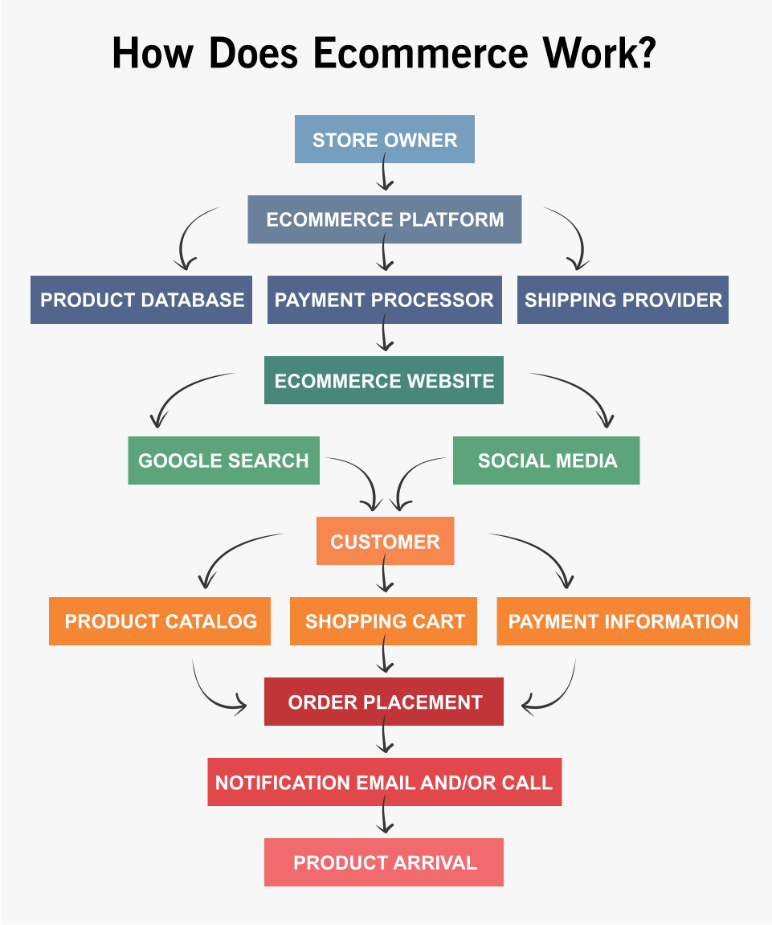
Example of a complex software system
Modern e-commerce platform

Slide 6
Example of a complex software system
Modern e-commerce platform consists of three primary components:
the front-end:
what users interact with directly
user interface (UI) components such as web pages, mobile apps, and other graphical elements
using technologies like HTML, CSS, JavaScript, and various front-end frameworks such as React.js or Angular.
communicates with the back-end through APIs (Application Programming Interfaces) to fetch data and perform various actions like searching for products, adding items to the cart, and placing orders.
the back-end
serves as the engine of the e-commerce platform, handling all the business logic and data processing.
managing user authentication, product catalog management, inventory management, order processing, payment gateway integration, and more.
built using server-side technologies such as Node.js, Python (with Django or Flask), Ruby (with Ruby on Rails), or Java (with Spring Boot).
interacts with the database to retrieve and store data and exposes APIs that the front-end and other external services can consume.
the database
where all the essential data of the e-commerce platform is stored, including user profiles, product details, inventory information, orders, and transaction records.
include relational databases like MySQL, PostgreSQL, or SQL Server, as well as NoSQL databases like MongoDB or Cassandra, depending on the specific requirements and data models.

Slide 7
Class activity - MCQ
Which platform is responsibly for managing user authentication, product catalog management, and orders?
Front-end
Database
Payment gateway
Back-end
2. To build the front end of an e-commerce platform and create interactive user interfaces, the following technologies are commonly used:
HTML, CSS, JavaScript
Python, C#
C++
MySQL

Slide 8
Class activity – MCQ – Answers
Which platform is responsibly for managing user authentication, product catalog management, and orders?
Front-end
Database
Payment gateway
Back-end
2. To build the front end of an e-commerce platform and create interactive user interfaces, the following technologies are commonly used:
HTML, CSS, JavaScript
Python
C++
MySQL

Slide 9

Managing complexity in an IT environment Six ways:
1. Understanding Complexity:
Imagine you're building a Lego structure. When the structure gets bigger and more intricate, it becomes harder to manage all the pieces and make changes without messing up other parts.
Similarly, in software development, complexity refers to how difficult it is to understand, change, and maintain a software system as it grows in size and functionality. (Reference: Sommerville, I. (2016). Software Engineering (10th ed.). Pearson.)
2. Why Complexity Matters:
As software projects become more complex, they become harder to manage, leading to delays, errors, and frustration for developers.
Complex software is like a tangled knot: it's tough to unravel, fix, or add new features without causing more problems. (Reference: McConnell, S. (2004). Code Complete: A Practical Handbook of Software Construction (2nd ed.). Microsoft Press.)

Slide 10

Managing complexity in an IT environment
3. Managing Complexity:
Just as you'd organize your Legos into different piles based on colour or shape to make building easier, software developers use strategies to manage complexity.
One strategy is to break down big tasks into smaller, more manageable pieces. This is like dividing a big project into smaller, bite-sized tasks that are easier to handle. (Reference: Larman, C., & Vodde, B. (2008). Scaling Lean & Agile Development: Thinking and Organizational Tools for Large-Scale Scrum. Addison-Wesley Professional.)
Agile methodology is one such strategy.

Slide 11


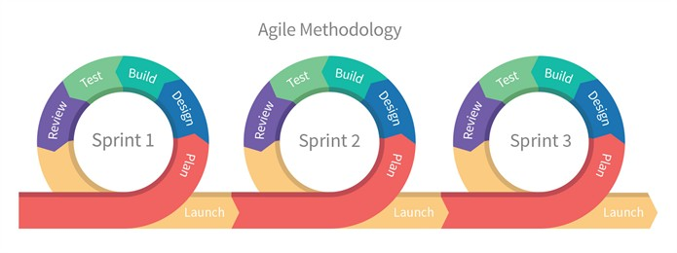

Managing complexity in an IT environment
4. Agile Methodology:
Agile is like working on a puzzle one piece at a time instead of trying to solve the whole thing at once.
With Agile, developers work in short bursts called sprints, focusing on completing small, achievable goals and getting feedback from users along the way. (Reference: Martin, R. C. (2003). Agile Software Development: Principles, Patterns, and Practices. Prentice Hall.)

Slide 12
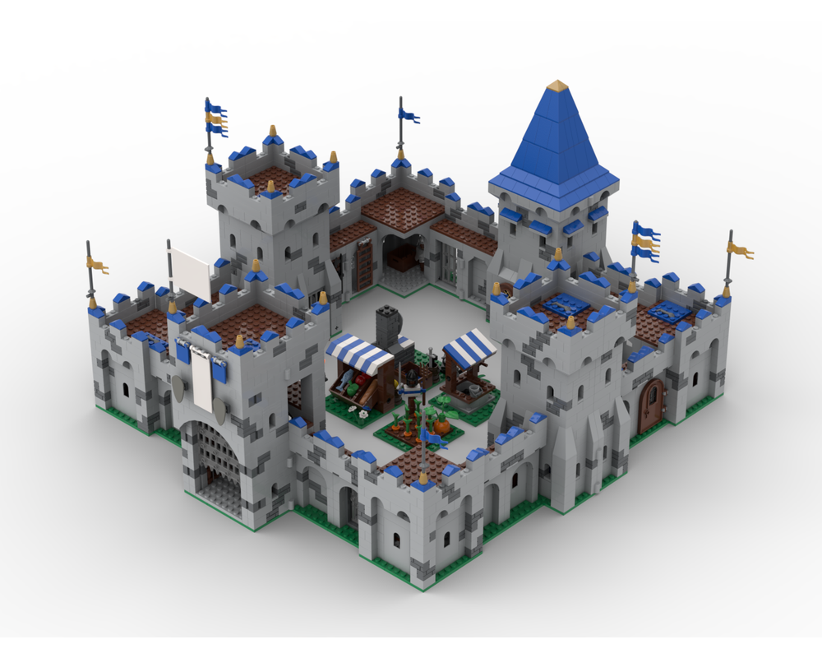
Managing complexity in an IT environment
5. Good Communication:
Imagine building a Lego castle with a friend. If you don't talk about your plan and work together, you might end up with mismatched pieces or parts that don't fit.
Similarly, in software development, good communication between team members is crucial for managing complexity. Developers need to share ideas, coordinate tasks, and solve problems together. (Reference: Cockburn, A. (2002). Agile Software Development. Addison-Wesley Professional.)
6. Continuous Improvement:
Building complex software is like building a skyscraper—it requires careful planning, constant adjustments, and teamwork.
By continuously learning from their mistakes, adapting to changes, and refining their processes, developers can better manage complexity and build software that meets users' needs. (Reference: Beck, K. (1999). Extreme Programming Explained: Embrace Change (2nd ed.). Addison-Wesley Professional.)

